Slide 2
Reproducible Analytical Pipelines
Leveraging reproducibility in statistical system production
Michael Cole
Quality and Improvement Division
Methods and Quality Directorate

Slide 3
Analytical pipeline
“The full process that produces statistics or an analytical publication”
Get
Analyse
Visualise
Report
Quality Assurance
Notes:
An analytical pipeline can be described as the full process that produces a statistical output. There are variations on how people describe them, but broadly there are 4 stages.
Getting the data
Analysing them
Producing visualisations and diagnostics
Producing the report
1, The Get stage refers to getting the data from data sources. Generally speaking, this is the part of the pipeline the data user has least control over and the software used to get the data is very dependent on where the data is stored and what format it is in. Data can be stored on local servers, web servers, on the web as files or you even might be scraping something like social media data. Depending on your data type you might use different software to import them for analysis. Excel and SQL Server Management Studio are widely used, but there is a big movement towards R and Python because they are open source and extremely flexible.
2, The Analyse stage refers to manipulating the data to get some intelligence out of it. You might be doing anything from calculating simple proportions to building models.
Data doesn’t always come in the most accessible format. There is a concept called tidy data which is very important for reproducibility and efficiencies, and a reference to a paper by Hadley Wickham is at the end of this presentation. Tidy data considers how the data will be used to determine the structure it is provided in. If the data aren’t in a tidy format they are called messy. The analyse section can include a large amount of data reformatting, or pre-processing, if the data are messy before they are usable.
3. The visualise stage is next. Visualisations are a useful way of communicating a lot of information in an accessible way. The way data are visualised often depends on the audience. A member of senior management often doesn’t have much time to spend looking at a complex visualisation, whereas a peer who is working on data at a similar granularity might want a lot of detail. Creating the optimal visualisation can take time but one good visualisation can quickly swing an important decision and be reused for talks, business cases and documentation.
Visualisations can be created using both analytical software as well as software that are commonly used by Graphic Designers.
4. Once the visualisations have been created they can be brought together with the commentary into a report. Historically, this has most often been done in software like Microsoft Word, but R and Python have the capability to do this too, which is extremely helpful because the user can incorporate the analysis within the same script that produces the final document.
Note that the output of a pipeline doesn’t HAVE to be a report. It could be several documents, or datasets, a dashboard, or a mixture of these things.
5. In many organisations the analytical pipeline needs to be underpinned by a quality assurance process to ensure each stage of the pipeline has been performed accurately. This often means that an independent person or people check or recreate what has been done for some or each stage.

Slide 4
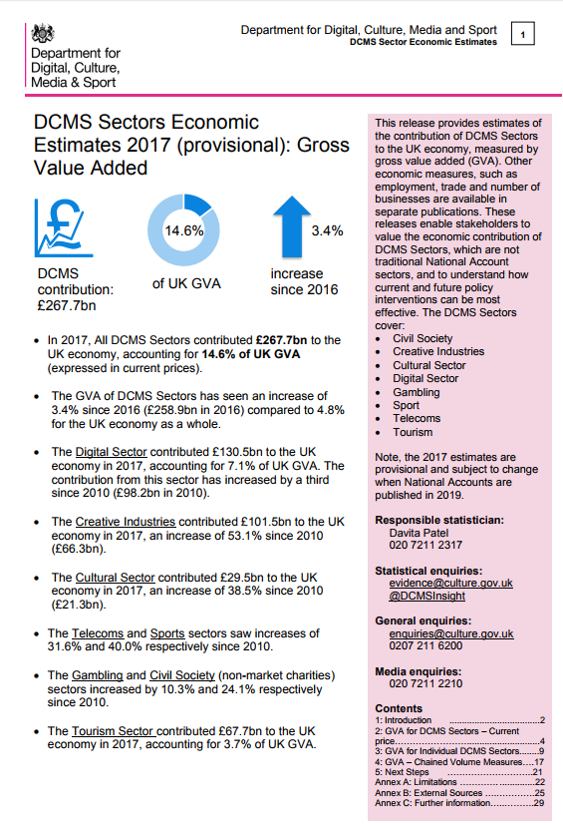
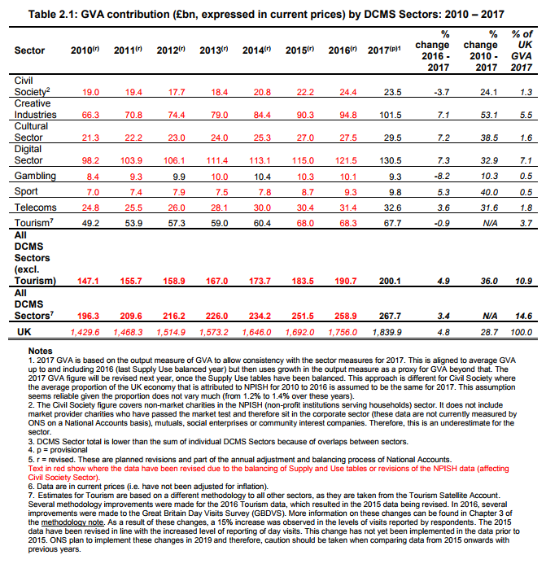
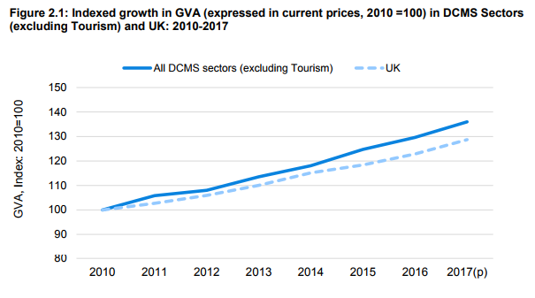
Notes:
In UK government, we produce a lot of statistical content like this. Mostly, these reports are produced by analyst teams on a bespoke basis. RAP is about making that process as resilient, transparent and re-usable as we can, by removing manual steps and generating as much as we can using software. We can’t automate everything – but we want to get to a position where the role of the analyst is really to add technical value and interpretation, not to spend their time copying and pasting tables and charts or making them manually.

Slide 5
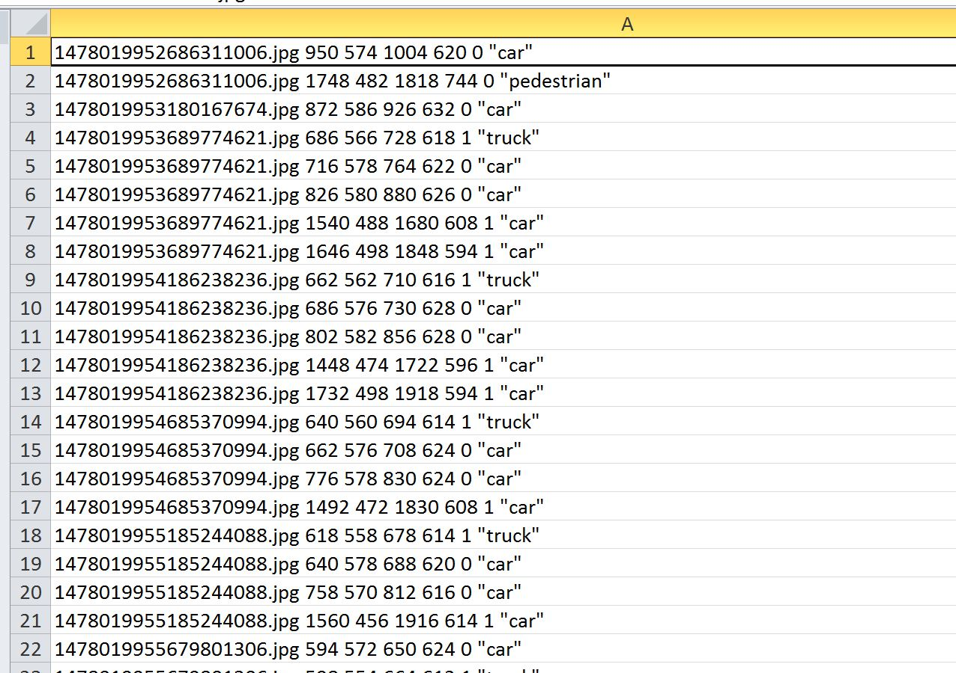
Notes:
Most piplines used to look something like this. Multiple inputs, into proprietary software tools, with outputs feeding into Word documents, PDF files or web pages.

Slide 6
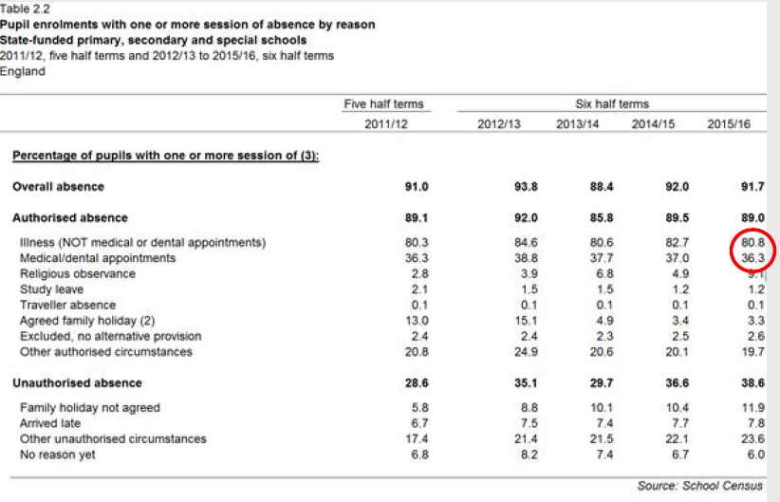
Manual cut and paste
Notes:
Generating the output in the Word document is often a manual process. This can involve, for example, cutting and pasting numbers from tables into written commentary, and graphs from Excel into Word. There is significant potential for mistakes here.

Slide 7
Manual pipelines carry quality risks
Outputs take a long time to produce, assure and reproduce
Inputs and outputs are not connected, except through manual steps
Processes are hard to follow and tedious to perform, increasing risk
“Copy and paste” and repetitive manual steps are very error-prone
It is hard to track changes without a lot of manual effort
Notes:
So in summary, statistical pipelines that are largely manual are full of quality risks. Repetitive tasks, copy and paste and other tedious manual steps can be frustrating and hard to carry out for long periods of time. They are also laborious, hard to redo and hard to reproduce. Inputs and outputs rely on human intervention to get from one to the other.

Slide 8
Example – London Whale
The trader known as the London Whale lost at least $6.2 billion for JPMorgan Chase & Co. in 2012
“the model operated through a series of Excel spreadsheets, which had to be completed manually, by a process of copying and pasting data from one spreadsheet to another”
Notes:
“the model operated through a series of Excel spreadsheets, which had to be completed manually, by a process of copying and pasting data from one spreadsheet to another”
“There is some evidence the Model Review Group accelerated its review as a result of this pressure”
This is a famous example of how cutting and pasting in Excel can cause serious quality problems – in this case resulting in a huge financial loss. Complex processes that rely on manual actions like this are very risky.

Slide 9
How is manual analysis checked?
Eyeball checks, like comparing output cells or manually checking formulae
Sense checks / visual comparison against other data
Repeating the analysis using different people
Dual running on separate computers and comparing answers
Notes:
Each stage of an analytical pipeline should be underpinned by a quality assurance (QA) process. In manual processes, these are typically quite limited and carry human error risk. At the same time, they can be very resource intensive and slow.

Slide 10
Reproducibility
“A result is reproducible when the same analysis steps performed on the same dataset consistently produce the same answer.”
The Turing Way,
handbook for reproducible, ethical and collaborative data science​
“It is the only thing that an investigator can guarantee about a study”
Professor Roger D. Peng, ​
Johns Hopkins Bloomberg School of Public Health ​
Notes:
Reproducibility is vital to research, and has become a very important topic in academic literature. Different sciences define reproducibility differently, but we use the definition from the Alan Turing Institute’s Turing Way handbook.
That is, “a result is reproducible when the same analysis steps performed on the same dataset consistently produces the same answer”.
Reproducibility is so important because it is the only thing that an investigator can guarantee about a study. We can’t promise that we will always be accurate or representative, but we can ensure reproducibility.
The best way to ensure reproducibility for statistical outputs is by using the RAP principles.
In addition to being reproducible, pipelines should also be auditable and assured. This means that there is a clear record of how the analysis has been done, evidence that it is fit for purpose.

Slide 11
Reproducible Analysis Principles
Open-source software
Version control
Embedded documentation
Automated quality assurance
Minimise manual steps
Maximise transparency
Improved quality
Better knowledge management
Increased trust
More efficient
Better business continuity
“Analysis as code”
Notes:
What does making analysis reproducible involve? These are the features of RAP.
Analysis as code – This is the idea that the end to end process of statistical production is written in code that follows software engineering good practices.
Open source software like R or python – so that users and other analysts can replicate the results without having to also pay for licenses, so that we can use existing open source software that is high quality, so that we are more likely to be able to reproduce these results into the future.
Version control using git – so that we have a clear record of who made what change for what reasons when. Crucial for understanding why decisions were made, getting the full story of policy decisions or operation decisions. Also just quite useful as a developer.
Embedded documentation – documentation that isn’t in a separate place from the product. Good documentation is written in one place, and one place only. That is within the product – next to codebase, made easy to read. Papers, reports, all embedded in that product within the version control system and automatically generated so that you don’t end up with multiple versions of the truth.
Automated quality assurance – not to replace humans, but to aid them. Automated testing, and building your codebase with tests in mind so that everytime you are running your code you can be reasonably confident that it is doing wat you want it to do. So that when you make changes you can be sure the behaviour hasn’t changed where you don’t want it to.
Minimise manual steps – this is the only nod to automation really, and notice how the automation is in service to other goals rather than an end in itself.
Maximise transparency – open source your code, in line with government guidance to open source your code unless it’s unreleased policy or fraud detection algorithms (or national security etc.)
If you implement these principles we believe that you will improve the quality of your work, you will improve the trust others have and you have in your work, you will make your processes more efficient, you will have better business continuity in case of staff changes or emergency situations, and you will have better knowledge management for others to use your work.
In practice… [next slide]

Slide 12
A reproducible analytical pipeline
Managed software package
Get
Visualise
Report
Analyse
Python pipeline
csv files
Output
Data products
Remote databases
Version
control
Code
hosting
Automated
Testing
Code
coverage
Notes:
This is an example of what a pipeline typically looks like. Multiple inputs enter an end to end process written in code. In this case, the code is written in python. The process is underpinned by coding good practices – version control managed with Git, code hosted on an online repository to enable collaboration, code tests are run automatically and the proportion of the code covered by automated tests is reported.

Slide 13
What does this look like in practice?
Bulletins populated automatically by code, along with charts, tables and documents
Datasets formatted, validated and built automatically
Automated QA such as reports, logs and validation plots generated during the run
Code hosted remotely, with version control so everybody working on it knows who did what, when and why
Notes:
We’ve often found when we present these ideas that people find them quite abstract. So this slide an the next two try to set out some examples of what this looks like in practice. When we presented to India, they didn’t really get the difference between this and a standard DST automated process. I think the point is that RAP is more flexible and agile than trying to set a process in stone forever – because for most statistical bulletins, the outputs change with each release, unlike a data pipeline where the process is very static.

Slide 14
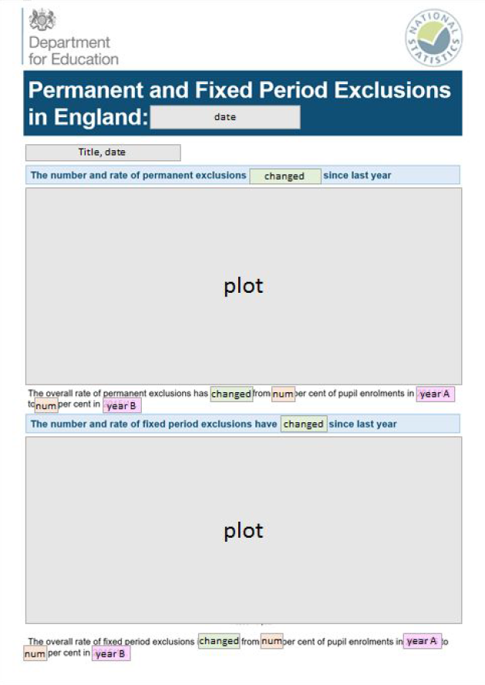
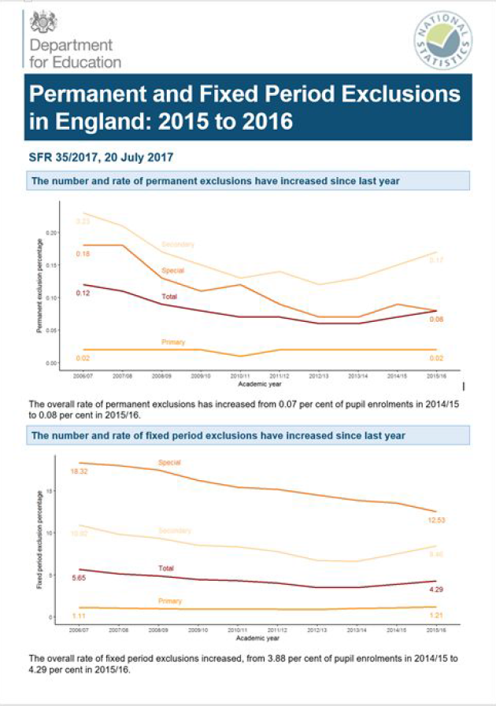
Notes:
An example of an R markdown template on the left, and the template as populated during the pipeline run. This is about minimising cut and paste risks – the elements that need updating like numbers and graphics are automatically populated by the pipeline code.

Slide 15
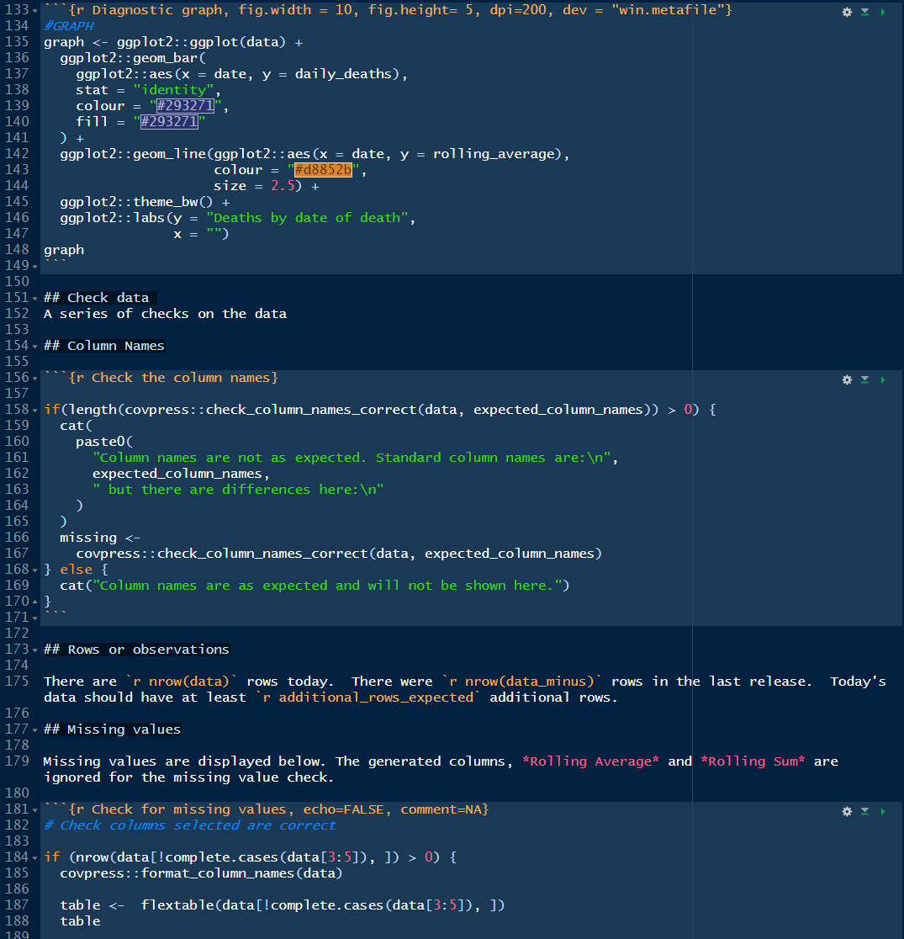
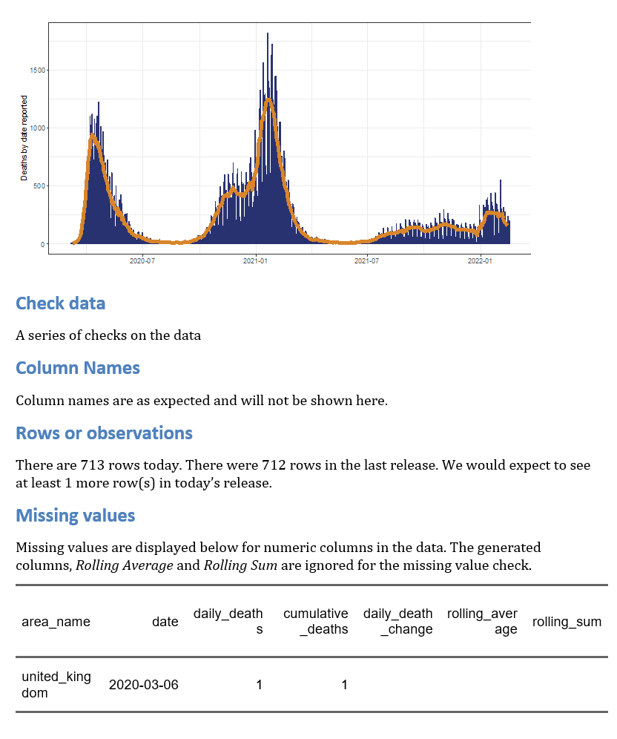
Notes:
An example of the R code that generates the report on the right. This is an excerpt from a QA report (actually numbers of cases during the COVID-19 pandemic, I think) – the point being that you can tailor this content to be whatever you need as a quality assurer. This is about removing the need for an analyst to compute this stuff manually. The outputs can be fed into a QA report for manual checking, or automated quality checks, or both. And once we have this process, introducing new checks is easy, as the code is modular. We can also re-use the assurance code for other things.

Slide 16
A RAP Minimum Viable Product
Minimise manual steps, for example copy-paste, point-click or drag-drop operations. Where it is essential to include a manual step, this must be documented.
Use open-source software which is available to anyone. We use R or python. Open-source tools integrate well with software engineering toolchains, and anybody can use them.
Use peer review of methods and code to ensure that the process is reproducible.
Guarantee an audit trail using version control software, preferably Git.
Make code open to anyone – enabled easily by using file and code sharing platforms
Make well-commented code and have documentation embedded and version controlled within the product, rather than saved elsewhere
Follow existing departmental good practices for quality assurance
ONS minimum standard for reproducible analytical pipelines
Notes:
Implementing even one of the RAP techniques will improve the trustworthiness and quality of our analysis. However, the RAP champions network for UK government has set out a RAP Minimum Viable Product (MVP) as follows.
At a minimum, a RAP must:
Minimise manual steps, for example copy-paste, point-click or drag-drop operations. Where it is absolutely necessary to include a manual step in the process this must be documented as described below.
Be built using open source software which is available to anyone, preferably R or python.
Deepen technical and quality assurance processes with peer review to ensure that the process is reproducible and that the below requirements have been met.
Guarantee an audit trail using version control software, preferably Git.
Be open to anyone – this can be facilitated most easily through the use of file and code sharing platforms.
Follow existing good practice for quality assurance – guidance set by departments or organisations, and by the Analysis Function teams and Data Quality Hub for the Analysis Function and Government Statistical Service.
Contain well-commented code and have documentation embedded and version controlled within the product, rather than saved elsewhere.
At ONS, we’ve set the bar a bit higher, because we’ve got the technology in place to include some more advanced practices. The link at the bottom of the page goes to the ONS RAP Standard (a public website).

Slide 17
RAP benefits: efficiencies
RAPs reduce processing time and analyst resource needed to produce our statistical outputs
Typical FTE savings of from 50 to 95% of analyst time
The efficiency gain depends on the design and frequency of the process
We see the biggest benefits with very labour-intensive manual processes, especially if they are run lots of times
RAP means we can free up analysts to do more analysis and less manual processing
Notes:
This is what we’ve learned from implementing RAPs in ONS and in other government departments.
In general, implementing RAP provides large savings in analyst time to run an end-to-end statistical process. Exactly how much depends on the process. Very regular processes with lots of manual steps tend to bring the biggest savings when using RAP, but even moving from very simple repetitive scripts to modular code can bring big advantages.
As an example, our Quarterly Greenhouse Gases publication used to take two people 4-6 weeks, four times a year (240 person days). The equivalent RAP process takes one person 3-4 days (16 person days) – a reduction in time taken of 93%.

Slide 18
RAP benefits: quality improvement
Processes are well documented, so easier to understand
Processes are easier and faster to maintain and debug
We can re-use modular pipeline components
RAP is helping us to move our workflows to cloud-based environments more quickly
RAP can be applied even for very high-pressure work
Notes:
RAP also brings some harder-to-measure benefits, most notably around improving quality and ease of assurance. We’ve found that RAP pipelines are easier and faster to fix when they go wrong, easier to understand (so new staff can pick them up more quickly) and because we can redeploy code modules we avoid reinventing the wheel. We’ve also found that even high pressure work with fast turnaround times benefits from RAP.

Slide 19
RAP brings quick benefits when
Analysis is time-consuming, highly labour intensive, or difficult to assure
You need the workflow to be efficient, trustworthy and easy to assure
You need to improve resilience, minimise single points of failure and ensure you have a full audit trail
You want to maximise re-use of resources and opportunities for collaboration
Notes:
These are scenarios where deploying RAP usually creates very quick realised benefits.

Slide 20
RAP works when
Senior managers provide commitment and advocacy
Team members are committed to the work
Teams have enough time to contribute
There is a base level of technical understanding
The right tools are in the right place
There is a plan to move to business as usual and resource to maintain pipelines
There is a supportive community of practice
Notes:
But if we’re going to achieve all that, we need these building blocks to be in place from the start. We’ve found that when these things are not in place, moving to “analysis as code” is much harder to do.

Slide 21
RAP is hard to do when
There is limited access to open-source tools
Coding capability is limited
Moving to RAP is not seen as a positive culture change
Not enough time is set aside to do RAP
Notes:
Organisations need the right tools in place to implement RAP. This usually means open source tools.
When we’ve tried implementing the RAP way of working with teams who have little coding capability, we found that the learning curve is usually too steep for them.
We need the right buy in from the top. Without senior sponsorship and understanding of why RAP is important, it is unlikely that embedding RAP will succeed.
Finally, teams need time and space to build capability and learn this new way of working. We’ve found that it takes about 3-4 months (working a couple of days a week) to bring somebody with a good basic understanding of coding to the level where they can build and maintain RAPs, based on our approach to embedding the skills (see slide 23 “Embedding RAP in ONS teams”

Slide 22
The main challenges
Skills retention, in teams and organisations
Capability – getting to a critical mass
Of coding competency
Of managers who can manage and assure RAPs
Developing a culture that promotes “analysis as code” as the standard way to build analysis
A technology stack that enables RAP practices
Risk aversion to developing in the open
Notes:
These are the big challenges we’ve faced in ONS as we try to move to this way of working.

Slide 23
Embedding RAP in ONS teams
We start small and grow incrementally
We develop early examples to demonstrate value and impact
Teams learn by doing not by sitting through courses
We use “just-in-time learning” so training is used immediately
Teams learn together, through paired development and mentoring support
We build in good practice from the beginning
Version control
Automated testing
Full documentation
Packaging code
Notes:
When we work with teams to build capability in automating statistical workflows, this is the set of broad principles we adopt. The most important are the behavioural ones – that teams learn by doing, rather than being told how or what to do, and that we make extensive use of mentoring and paired working to build capability and reinforce good practice. Finally, we start as we mean to go on, building in version control, unit testing and writing good documentation right from the start.

Slide 24
Strategic enablers for RAP in UK government
“Open source by default” policy for UK government
Analysis Function RAP Strategy to deliver analysis with RAP by default
Consultancy and mentoring support for analyst teams
Tools, guidance, standards and policies to promote RAP practices
Examples of “what good looks like”
ONS RAP and Data Science communities of practice and peer review network
RAP learning pathway to build capability
Cross-government RAP champions' network
Notes:
These are some of the enablers in place in UK government and ONS to promote and prioritise RAP. We’ve found that having these things in place really helps to build momentum.

Slide 25
RAP Guidance
Code QA Checklists
Quality assurance of code should be proportionate to risk
RAP minimum standard
Minimum application of software engineering practice to analysis in ONS
Quality Assurance of Code for Analysis and Research (QACAR)
Sets out good practices for writing reproducible, transparent and resilient code
Notes:
I have already mentioned the minimum viable RAP guidance, but our key piece of documentation is the Quality Assurance of Code for Analysis and Research guidance, QACAR for short, and known affectionately as the Duck Book (QACAR = quack = duck).
This guidance outlines good practices in programming, written with government analysts in mind.
Pinning down what should be included in a minimum RAP was difficult, as it is very subjective and circumstantial.
We therefore also created three QA checklists to help people to understand where their projects are at and what they should be aiming for.
Which checklist you should use depends on the type of analysis you are doing, its risks and complexity.
These are available alongside the Duck Book.

